Slide 1


Bharatesh Education Trust’s Anuvartik Mirji Bharatesh Institute of Technology (AMBIT)
DEPARTMENT OF ARTIFICIAL INTELLIGENCE AND MACHINE LEARNING
Developed By | Prem Bhaganna Ashtagi
USN | 2HB24AI028
Semester | 4th Sem
Title of The Game | Intelligent Othello (Human vs AI)
Course Name | Artificial Intelligence
Course Code | BAD402

Slide 2
-: Problem Statement & Objective :-
Aim :- To design and develop an intelligent Othello game where a human player competes against an AI using decision-making algorithms.
Problem Specification :- The system should simulate a two-player adversarial game and allow the AI to make optimal moves based on the current board state.
Input :-
Player moves (mouse clicks).
Current board configuration.
Output :-
Updated game board with valid moves.
AI decision (best move).
Final result (Win/Loss/Draw).
Constraints :-
Limited computation time.
Must follow Othello rules.
Real-time response.
Functional Requirements:- ( Display board & pieces ),(Show valid moves (green dots) ),(AI decision making ),(Flip pieces correctly ),(Declare winner).

Slide 3
-: AI Concepts & Intelligence :-
Concepts Used :-
Minimax → Decision making.
Alpha-Beta → Faster search.
Heuristic → Smart evaluation.
Depth Limit → Time control.
Best-First → Smart move ordering.
Properties of the System :-
Adversarial Search Problem.
Deterministic Environment.
Fully Observable.
Turn-Based Game.
Zero-Sum Game.
Algorithm :-
Adversarial Minimax with Best-First Strategy.
Start from the current game state.
Generate all possible moves for the current player.
Evaluate each move using a heuristic function.
Order moves based on heuristic values (Best-First approach).
Recursively simulate moves for both players (Minimax principle).
At each level, maximize AI score and minimize opponent score.
Stop at depth limit or terminal state.
Select and return the best move.

Slide 4
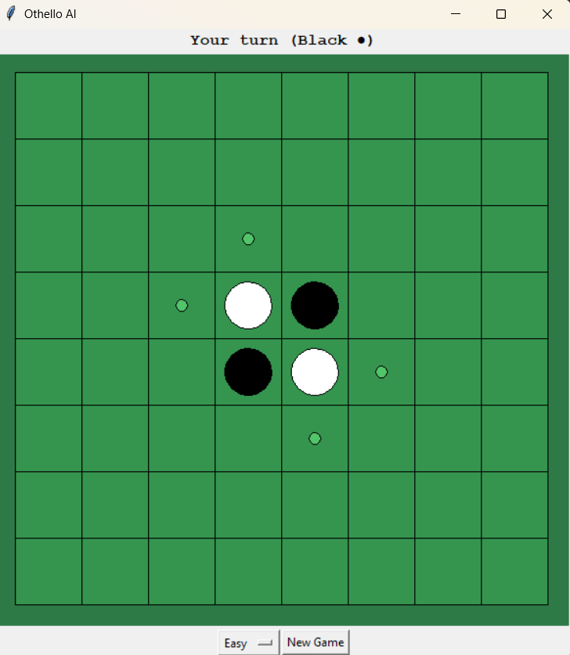
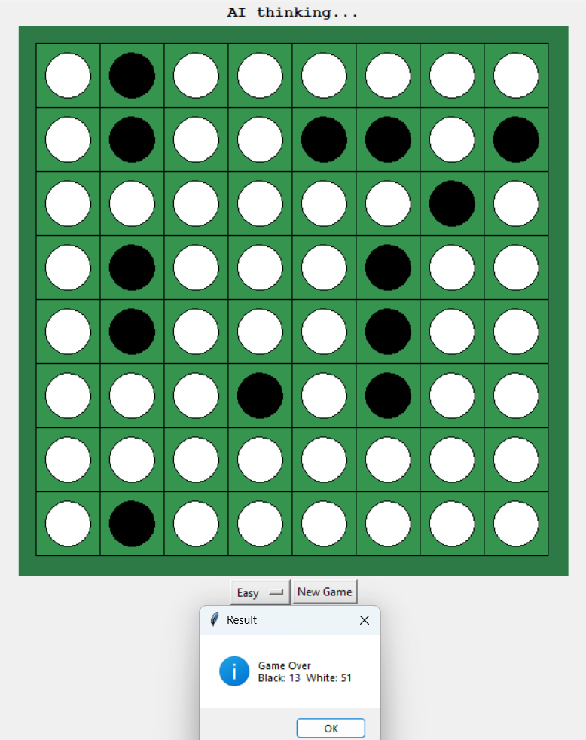
-: Working or Methodology :-
The game starts with the standard Othello board setup.
The human player (Black ●) makes a move.
The system calculates and displays valid moves.
The AI evaluates all possible moves using Minimax.
Moves are prioritized using heuristic (Best-First approach).
The best move is selected and applied.
Opponent pieces are flipped accordingly.
The process repeats until no moves are left.
The winner is decided based on the final score.

Slide 5
THANK YOU

